Slide 1
EFS IN aws
Introduction To ELASTIC FILE SYSTEM
How does EFS work
Use Cases Of cases
When To Choose EFS
Different storage classes/Performance And Throughput modes in EFS
Steps to configure and connect to EFS (ELASTIC FILE SYSTEM)
Features of EFS

Slide 2
INTRODUCTION TO AWS ELASTIC FILE SYSTEM (EFS)
AWS(Amazon Web Services) offers a wide range of storage services that can be provisioned depending on your project requirements and use case. AWS storage services have different provisions for highly confidential data, frequently accessed data, and the not so frequently accessed data. You can choose from various storage types namely, object storage, file storage, block storage services, backups, and data migration options. All of which fall under the AWS Storage Services list.

Slide 3
What is AWS Elastic File System?
From the aforementioned list, EFS falls under the file storage category. EFS is a file-level, fully managed, storage provided by AWS (Amazon Web Services) that can be accessed by multiple EC2 instances concurrently. Just like the AWS EBS, EFS is specially designed for high throughput and low latency applications.
How Does EFS Work?
EFS can be created using the EC2-Instance where it will be created in a specific region and distributed across multiple availability zones for the purpose of high availability and durability. You can choose the EFS based on the I/Ops you are going to perform.

Slide 4
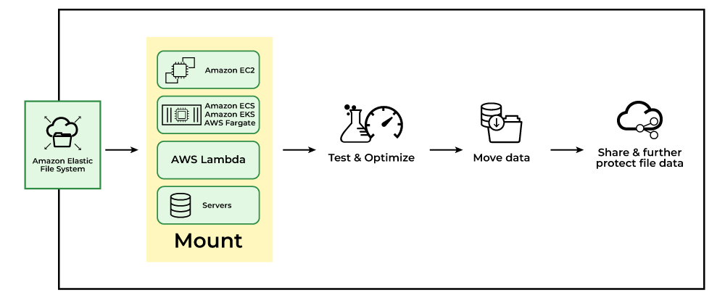
Once the EFS is created you need to set up mount targets which will provide the connectivity to your EFS file system. Following are some of the resources which you can mount on EFS.
Amazon EC2.
Amazon ECS
Amazon EKS.
AWS lambda and some other servers

Slide 5
Use Cases Of EFS
Secured file sharing:
You can share your files in every secured manner and in a faster and easier way and also ensures consistency across the system.
Web Hosting:
Well suited for web servers where multiple web servers can access the file system and can store the data EFS also scales whenever the data incoming is increased.
Modernize application development:
You can share the data from the AWS resources like ECS, EKS, and any serverless web applications in an efficient manner and without more management required.
Machine Learning and AI Workloads:
EFS is well suited for large data AI applications where multiple instances and containers will access the same data improving collaboration and reducing data duplication.

Slide 6
When To Choose Amazon EFS?
Shared File Storage: If the multiple EC2-Instances have to access the same data. EFS management of shared data and ensures consistency across instances.
Scalability: EFS can increase and decrease its storage capacity depending on the incoming data. If you don't have an idea how much data is going to come to the store then you can use the Amazon EFS.
Simplified Data Sharing: If different applications want the same data to use in a collaborative manner then you can choose the Amazon EFS. EFS can share large datasets across a group of instances.
Use with Serverless Applications: Amazon EFS is well suited for the service like serverless computing services like some of the examples AWS lambda, EFS, and so on.
Pay-as-You-go-Model: If your application is having unpredictable storage growth then there is no need of paying upfront or no need of any prior commitments. You pay only for the storage that you are going to use

Slide 7
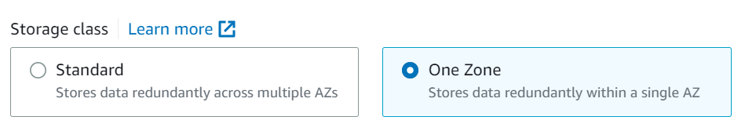
Different Storage Classes in AWS EFS
Standard storage class
This is the default storage class for EFS.
The user is only charged for the amount of storage used.
This is recommended for storing frequently accessed files.
Infrequently Accessed storage class(One Zone)
Cheaper storage space.
Recommended for rarely accessed files.
Increased latency when reading or writing files.
The user is charged not only for the storage of files but also charged for read and write operations.

Slide 8
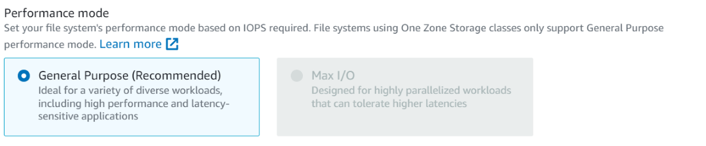
Different Performance Modes in EFS
General-purpose
Offers low latency.
Supports a maximum of 7000 IOPS.
As a cloud watch metric, you can view the amount of IOPS your architecture uses and can switch to Max IOPS if required.
Max I/O
This is recommended when EFS needs over 7000 IOPS
Theoretically, this mode has an unlimited I/O speed.

Slide 9
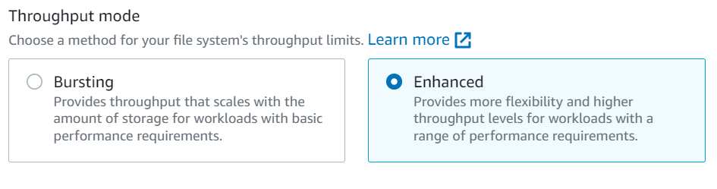
DIFFERENT THROPUGHPUT MODES IN EFS
Burst Mode: Allows 100MBPS of burst speed per TB of storage.
Provisioned Mode: Users can decide the max burst speed of the EFS but are charged more when speeds go beyond the default limit.
.

Slide 10
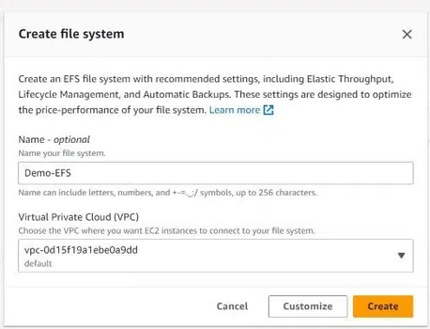
Steps To Configure and Connect To EFS(Elastic File Storage)
First, create an AWS account create
Step 1: Create an EFS from the AWS console. Choose the correct VIRTUAL PRIVATE CLOUD and configuration that suits your use case.

Slide 11
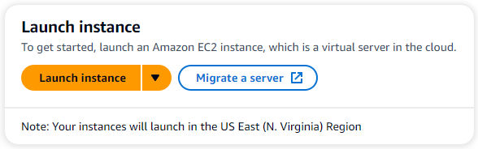
Step 2: Create one or more EC2 servers from the EC2 dashboard as needed for your use case.
Step 3: Allow the EC2 security group to access EFS. Connect To EFS from your EC2 servers. Primarily there are 2 methods of connecting to EFS from EC2 servers: Linux NFS Client: This is the old traditional method of connecting to file systems.EFS Mount Helper: This is the AWS-recommended and simpler solution to connect to EFS.

Slide 12
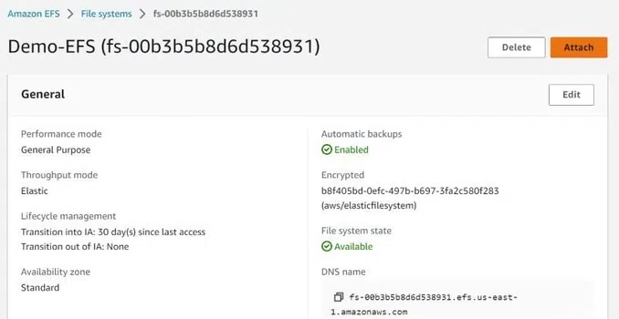
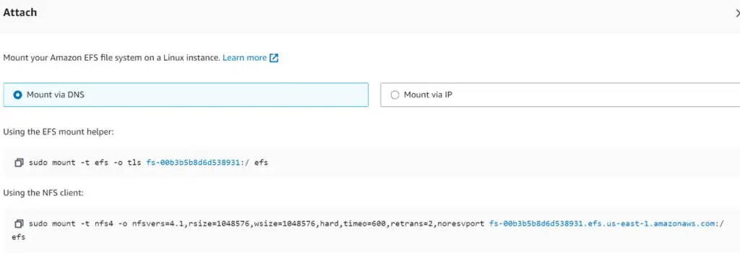

Slide 13
Once you have connected to AWS EFS from your EC2 instances you will have a folder of any name (say EFS-Folder) which will hold all the files in the EFS. Any file created in this directory can be seen or edited from any EC2 instances that have access to the EFS.
FEATURES OF EFS
Availability: AWS EFS is region specific., however, can be present in multiple availability zones in a single region.
EC2- instances across different availability zones can connect to EFS in that zone for a quicker access
EFS LifeCycle Management: Lifecycle management moved files between storage classes. Users can select a retention period parameter (in number of days). Any file in standard storage which is not accessed for this time period is moved to the Infrequently accessed class for cost-saving.
Note that the retention period of the file in standard storage resets each time the file is accessed
Files once accessed in the IA EFS class are then moved to Standard storage.
Note that file metadata and files under 128KB cannot be transferred to the IA storage class.
LifeCycle management can be turned on and off as deemed fit by the users.

Slide 14
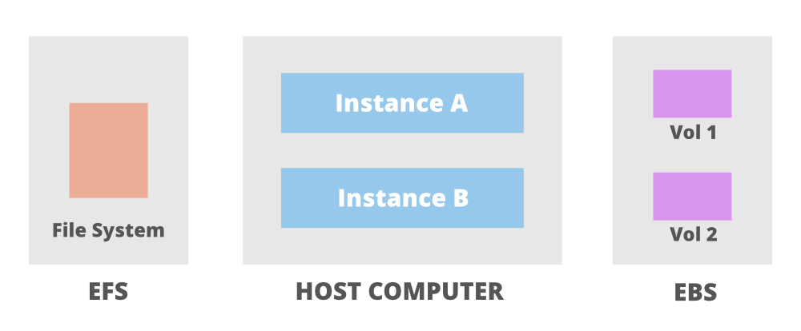
The above image shows an Elastic File System shared between two instances which are further connected to their own EBS volumes. The following are some use cases of EFS:
Multiple server architectures: In AWS only EFS provides a shared file system. So all the applications that require multiple servers to share one single file system have to use EFS.
Big Data Analytics: Virtually infinite capacity and extremely high throughput make EFS highly suitable for storing files for Big data analysis.
Reliable data file storage: EBS data is stored redundantly in a single Availability Zone however EFS data is stored redundantly in multiple Availability Zones. Making it more robust and reliable than EBS.

